Slide 1
Employee Data Analysis using Excel
STUDENT NAME: SHARMILA E
REGISTERNO:122204047/asunm1659122204047
DEPARTMENT:B.COM CORPORATE SECRETARYSHIP
COLLEGE: SHRI KRISHNASWAMY COLLEGE FOR WOMEN

Slide 2
PROJECT TITLE
Employee Gender Analysis using Excel

Slide 3


AGENDA
Problem Statement
Project Overview
End Users
Our Solution and Proposition
Dataset Description
Modelling Approach
Results and Discussion
Conclusion
3/21/2024 Annual Review

Slide 4

PROBLEM STATEMENT
The purpose of this analysis is to systematically examine employee data to uncover trends, patterns, and insights that can inform strategic decision-making. The focus will be on identifying key factors that impact employee performance, satisfaction, retention, and overall company productivity.

Slide 5

PROJECT OVERVIEW
Analyzing employee performance based on various factors involves a structured approach to evaluate their achievements, ratings, and patterns across different categories like high, medium, or low performers

Slide 6

WHO ARE THE END USERS?
Employees HR Personnel Managers/Supervisors Payroll Department IT/Admin Staffmin Staff

Slide 7

OUR SOLUTION AND ITS VALUE PROPOSITION
Excel's powerful data analysis and visualization tools to conduct an in-depth examination of employee data with a focus on gender analysis. This includes creating dashboards, generating pivot tables, and applying statistical functions to identify patterns, trends, and disparities across different dimensions, such as department, job level, salary, and promotion rates.

Slide 8
Dataset Description
Employee-kaggle 26 features 9-features Employee ID – number Name-text Employee type Proformance level Gender-Male,Female

Slide 9

THE "WOW" IN OUR SOLUTION
It empowers companies to not only understand their current state of gender equality but also to take proactive, data-driven actions that align with their values and business goals, ultimately leading to a more inclusive and competitive organization.
3/21/2024 Annual Review
9

Slide 10
MODELLING
DATA COLLECTION Kaggle selecting data grouping up into Excal FEATURE COLLECTION Employ name Empolyee ID Employee rateing empolyee gender PROFORMANCE LEVEL Exceptional Performance Above Average Performance Benchmark Performance
10

Slide 11
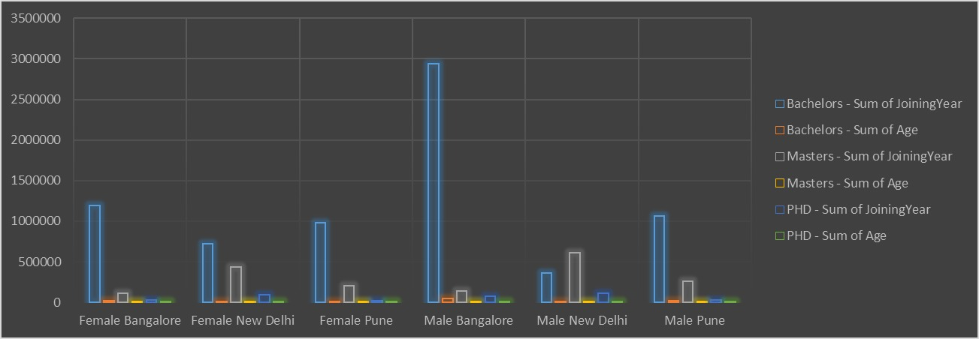
RESULTS
11

Slide 12
conclusion
Data-Driven Decisions: The insights gained empower informed, strategic HR decisions that align with organizational goals.Continuous Improvement: Emphasized the need for ongoing monitoring and analysis to adapt to changing workforce dynamics.Actionable Steps: Implementing the recommended strategies is expected to enhance productivity, equity, and employee satisfaction.
This concise conclusion slide encapsulates the key findings and takeaways from your employee data analysis, providing a clear and actionable summary for your audience.

